Slide 1
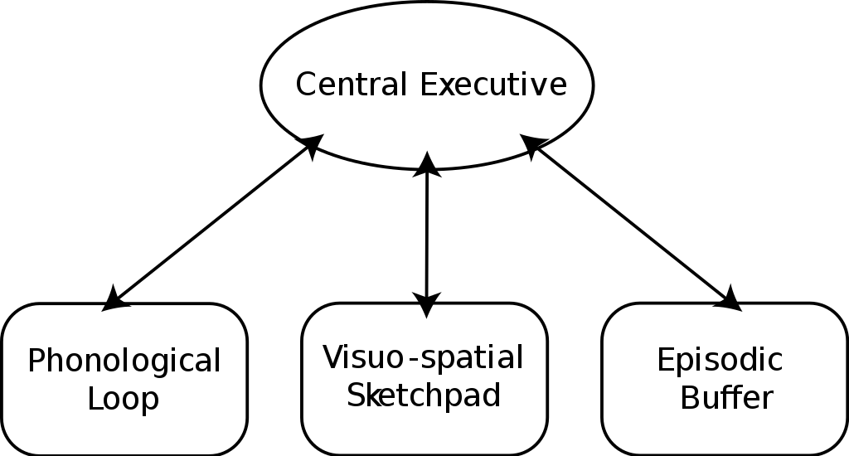
Explanations of Forgetting: 1) Interference
Monday, 05 December 2022
Memory
DO NOW:
Three components of the working memory model are the central executive, the phonological loop and the visuo-spatial sketchpad.
Briefly outline each of these components:
Central executive
Phonological loop
Visuo-spatial sketchpad
EXT: Explain one strength of the working memory model.
STRETCH: Use an issue and debate to evaluate the working memory.

Slide 2
Explanations of Forgetting: 1) Interference
Monday, 05 December 2022
Memory
KEY QUESTIONS:
How does interference theory explain forgetting?
What is proactive interference?
What is retroactive interference?
How does McGeoch and McDonalds (1931) research support interference theory of forgetting?
How can interference theory of forgetting be evaluated in terms of its strengths and limitations?

Slide 3
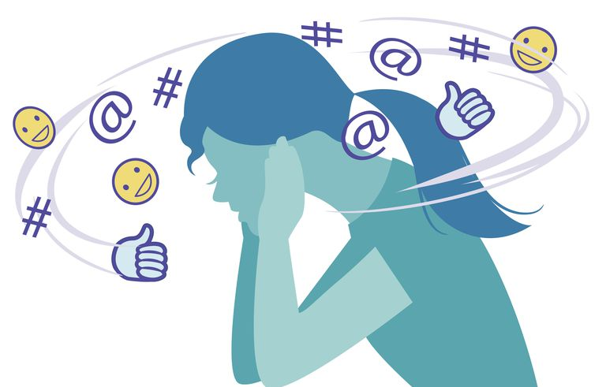
Interference Theory
Explanations of Forgetting
In this lesson, we are going to look at interference as an explanation for forgetting in LTM:
Once information has reached LTM it is more-or-less permanent meaning that ‘forgetting’ in the LTM is likely because we can’t access the memories.
Interference theory states that forgetting occurs because memories interfere with one another and end up disrupting each other which leads to forgetting. (Baddeley, 1999).

Slide 4
Types of Interference
Explanations of Forgetting: Interference
Retroactive interference: Recent information hinders the recall of older information.
An example would be calling your ex-girlfriend by your new girlfriend’s name
Proactive interference: Past information hinders the recall of new information
When trying to recall a new phone number, the old phone number you have previously had for years could proactively interfere with the recall, to the point when it is very difficult to remember the new number.

Slide 5
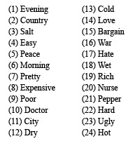
Key Research: McGeoch & McDonald (1931)
Explanations of Forgetting: Interference
McGeoch & McDonald (1931) studied retroactive interference by varying the amount of similarity between sets of word lists presented to participants.
PROCEDURE:
All participants had to learn a list of 10 word until they could remember them with 100% accuracy.
They were then split into six groups and each group was required to learn a new list.
Word list example:

Slide 6
Key Research: McGeoch & McDonald (1931)
Explanations of Forgetting: Interference
After all participants learnt list 1, They were split into 6 groups where each group had to a learn one of the six word lists below:
Synonyms – Similar meanings (big, large, huge, grand)
Antonyms – Opposite words (big and small)
Words unrelated to List 1 (caterpillar)
Nonsense syllables (bhljw)
Three-digit numbers (476)
No new list – participants could rest.
Which of these word lists do you think would produce the most interference?

Slide 7
Key Research: McGeoch & McDonald (1931)
Explanations of Forgetting: Interference
FINDINGS:
The most similar material (synonyms) produced the worst recall showing that interference is strongest when memories are similar.
Those who had learned synonyms in the second list were significantly impaired, down to 12%.
TASK: Use the graph to explain McGeoch and McDonald’s (1931) findings.

Slide 8
Proactive or Retroactive Interference? Explain your answer.
Dan learned to drive a manual car, however, has recently purchased an automatic. When on holiday, Dan rents a car which is a manual and keeps stalling the car because he forgets to press the clutch.
Judy received her new credit card and memorised the PIN number 4159. However, when she is paying for shopping in ASDA, she uses her old credit card and can no longer remember the PIN.
Lucas learned Spanish at primary school. However, when he started secondary school, he learned French as well as Spanish. One day the French teacher asked him what the word for ‘hello’ is, and he replied ‘Hola’.
Jodie has recently got a new mobile number and can finally remember it. After a few months, her mother asks him for his old number, and she can no longer recall it.
Retroactive – Dan’s new memory of driving an automatic is interfering with his old memory of driving a manual.
Retroactive – because her new PIN number is interfering with her memory of her old PIN number.
Proactive – because his old knowledge of Spanish is interfering with his ability to recall the French word for hello
Retroactive – her new mobile phone number is hindering recall of her old number.

Slide 9
Exam Practice: Short Answer Questions
Explain proactive interference as an explanation for forgetting. [2]
Explain retroactive interference as an explanation for forgetting. [2]
Outline interference as an explanation for forgetting. [4]
Describe one study in which interference as an explanation of forgetting was investigated. Indicate in your answer the method used and the results obtained. [6]

Slide 10
Check your knowledge answers:
Explain proactive interference as an explanation for forgetting. [2]
Proactive interference is when recent/new information hinders the recall of old information.
Explain retroactive interference as an explanation for forgetting. [2]
Retroactive interference is when past/old information hinders the recall of new information

Slide 11
Outline interference as an explanation for forgetting. [4]
Interference is an explanation for forgetting in long term memory.
Interference theory states that interference occurs when information that is similar in format gets in the way of the information that someone is trying to recall.
There are two types of interference; retroactive which is when new information hinders to recall of old information and proactive interference whereby past information hinders to recall of new information.

Slide 12
Describe one study in which interference as an explanation of forgetting was investigated. Indicate in your answer the method used and the results obtained. [6]
McGeoch & McDonald (1931) tested their hypothesis that words with the same meaning would be more prone to interference than information that was unrelated.
Participants were given a list of words that they practised until they could recall with 100% accuracy. They were then given another list to remember. The second lists varied, so for example sometimes the second list was totally unrelated e.g. a list of numbers. Others were given a second list that contained synonyms of the first (words of the same meaning such as large and big).
When asked to recall the first list (which they had previously recalled accurately) it was found that those who had learned synonyms in the second list were significantly impaired, down to 12%.
Whereas learning unrelated information in the second list produced less impairment – McGeoch and McDonald (1931) therefore concluded interference was most likely to occur when material being remembered was similar.

Slide 13
Evaluation: Interference as an Explanation for Forgetting
Evaluation Point | Strength or Limitation? | Explain why. | STRETCH: Further this point…
Thousands of lab experiments have been carried out into this explanations of forgetting, such as McGeoch and McDonald’s research. Most of these studies show that both types of interference discussed are very likely to be common ways we forget information from LTM. |  |  | Evaluate the validity of lab studies.
The stimulus materials used in most studies are word lists. Although learning lists of words is definitely has more mundane realism that learning consonant trigrams (such as TZK), this still doesn’t accurately represent the thing we learn and try to remember in everyday life i.e. faces, birthdays, grocery lists etc. |  |  | What type of stimulus materials could be used instead of world lists to ensure experiments have mundane realism?
Baddeley & Hitch (1977) wanted to find out if interference was a better explanation for forgetting than that time elapsed. They asked Rugby players to remember the names of the teams they had played in that season, week by week. Their results clearly showed that accurate recall did not depend on how long ago the matches took place but what was more important was the number of games they played in the meantime. So, a player’s recall of a team name from three weeks ago was better if they had played no matches since then. |  |  | Explain why this study has ecological validity.
For practical reasons, in interference studies the time periods are relatively short and may in some case they are very short indeed. This means that a participant may have to learn one list of words, and then learn a second one 20 minutes later, and then recall one of them a few minute after that (the whole process could be over within an hour!). |  |  | Explain why such studies are reductionist explanations of interference.
Tulving & Psotka (1971) gave participants give lists of 24 words, each list organised into six categories e.g. hut, cottage, tent, hotel, cliff, river, hill, volcano, captain, corporal, sergeant, colonel, ant, wasp, beetle, mosquito, zinc, copper, aluminium, bronze, drill, saw, chisel. The categories were not explicit but it was presumed that they would be obvious to participants. Recall was about 70% for the first word but this fell as participants were given each additional list to learn presumably due to interference. However, at the end they were given a cued recall test – they were told the names of the categories as a clue, recall again rose to about 70%. |  |  | Evaluate Tulving & Psotka’s study here.
EXT: Create an essay plan for this lesson.
STRETCH: Write out a triple whopper paragraph.

Slide 14
EVIDENCE FROM LAB STUDIES
Thousands of lab experiments have been carried out into this explanations of forgetting, such as McGeoch and McDonald’s research. Most of these studies show that both types of interference discussed are very likely to be common ways we forget information from LTM.
STRENGTH – Lab experiments control the effects of extraneous variables and thus give us confidence that inference is a valid explanation for at least some of the forgetting that occurs in the LTM.

Slide 15
ARTIFICIAL MATERIALS
The stimulus materials used in most studies are word lists.
Although learning lists of words is definitely has more mundane realism that learning consonant trigrams (such as TZK), this still doesn’t accurately represent the thing we learn and try to remember in everyday life i.e. faces, birthdays, grocery lists etc.
LIMITATION – The use of artificial tasks makes interference much more likely in the lab. Interference may not be as likely an explanation for forgetting things in everyday life as it is in the lab.

Slide 16
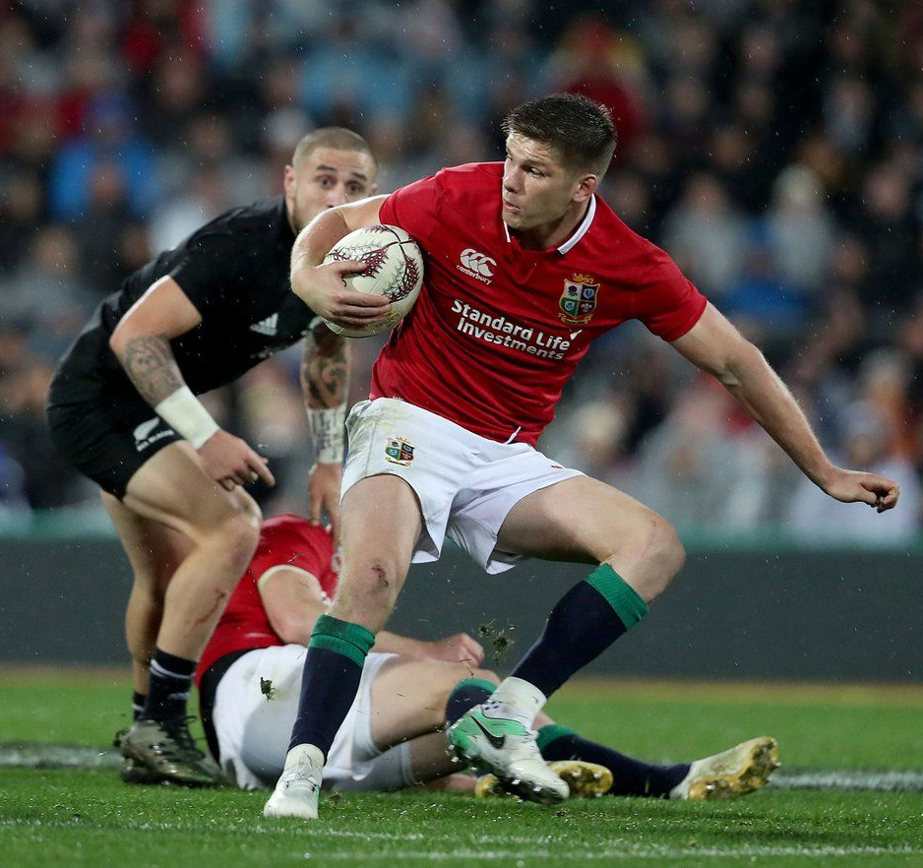
REAL-LIFE STUDIES
Baddeley & Hitch (1977) wanted to find out if interference was a better explanation for forgetting that time elapsed.
They asked Rugby players to remember the names of the teams they had played in that season, week by week.
Their results clearly showed that accurate recall did not depend on how long ago the matches took place but what was more important was the number of games they played in the meantime.
So, a player’s recall of a team name from three weeks ago was better if they had played no matches since then.
STRENGTH – Demonstrated the effect of interference in an everyday situation.

Slide 17
TIME BETWEEN LEARNING
For practical reasons, in interference studies the time periods are relatively short and may in some case they are very short indeed.
This means that a participant may have to learn one list of words, and then learn a second one 20 minutes later, and then recall one of them a few minute after that (the whole process could be over within an hour!).
LIMITATION – This doesn’t necessarily reflect how things are learnt in the real world and questions the validity of experiments investigating interference.

Slide 18
INTERFERENCE EFFECTS MAY BE OVERCOME USING CUES
Tulving & Psotka (1971) gave participants give lists of 24 words, each list organised into six categories e.g. hut, cottage, tent, hotel, cliff, river, hill, volcano, captain, corporal, sergeant, colonel, ant, wasp, beetle, mosquito, zinc, copper, aluminium, bronze, drill, saw, chisel.
The categories were not explicit but it was presumed that they would be obvious to participants.
Recall was about 70% for the first word but this fell as participants were given each additional list to learn presumably due to interference.
However, at the end they were given a cued recall test – they were told the names of the categories as a clue, recall again rose to about 70%
LIMITATION – With a cue present participants were able to recall more words - This shows did have the information stored in LTM but because of the similarity between words interference did likely take place.

Slide 19
You have 2 minutes to complete the planning box for the essay below.
PLENARY
Describe and evaluate interference as an explanation for forgetting. [16 marks]
You may use this space to plan your answer.

