Slide 1
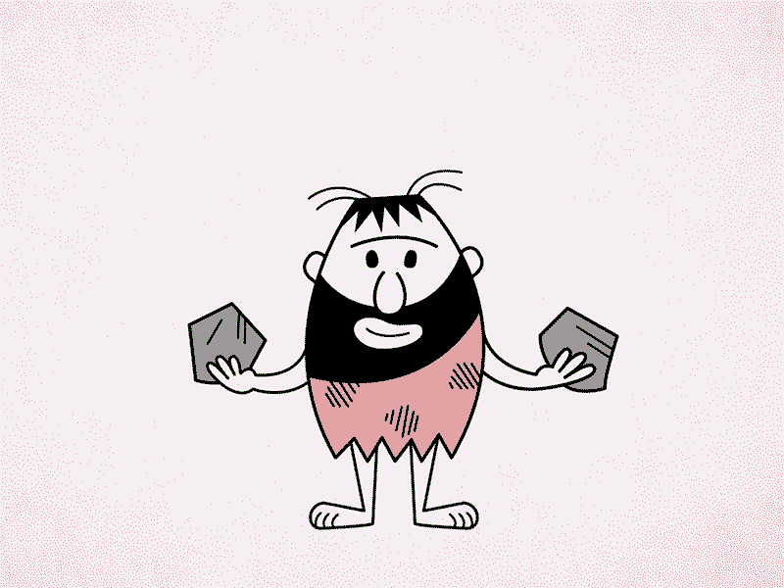
Comparisons Questions
These are ways of measuring evaluation (AO3)
Can occur in ANY paper on ANY topic
Theme / point of comparison is crucial

Slide 2
Comparisons Questions
Theme / point of comparison is crucial as it is the only way to show evaluation in this question. Otherwise it is description.

Slide 3
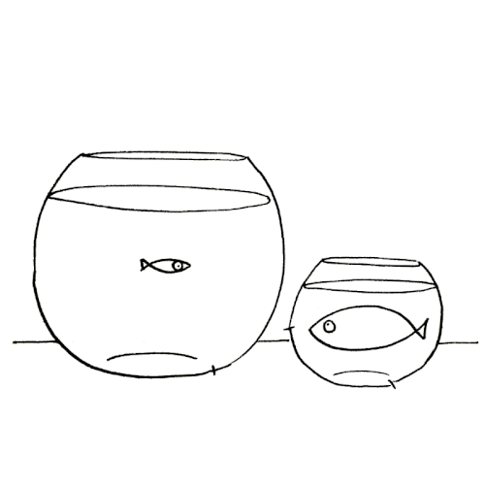
Outline one difference between Paull’s and Ridings [3]
Description
Paull’s is boarding
Riding’s is a day house.
Description

Slide 4
Outline one difference between Paull’s and Ridings [3]
The difference is the status / fees of the members of the house.
Paull’s is boarding
Riding’s is a day house.
Difference
Evidence
Evidence

Slide 5
Outline one difference between lab and field experiments [3]
The difference is its location.
Lab experiments are in a controlled environment
Whereas field experiments are in a natural environment
Difference
Evidence
Evidence

Slide 6
Outline one difference between a treatment from the Medical Model and a treatment from the Alternatives[3]
The difference is how long each treatment works for.
Medication is palliative, so works while it is being taken
Whereas CBT / Flooding can be curative and can be effective permanently
Difference
Evidence
Evidence

Slide 7
Similarities
Theme / point of comparison is still crucial but harder to do AND it is harder to give evidence

Slide 8
Outline one similarity between Paull’s and Ridings [3]
Both are girls houses.
Paull’s is a girls’ house
Ridings is a girls’ house
Similarity
Evidence
Evidence

Slide 9
Outline one similarity between Paull’s and Ridings [3]
Both have house mistresses
Ms Gratton is HSM of Paull’s
Ms Jones is HSM of Ridings
Similarity
Evidence
Evidence

Slide 10
Outline one similarity between Kohlberg and Lee [3]
Try NOT to choose the area the core studies are in OR their tagline as this makes it very difficult to come up with evidence.

Slide 11
Outline one similarity between Kohlberg and Lee [4]
Both K&L had nomothetic large samples [1]
which is beneficial to show universal development [1]
K’s sample was of 75 American males (Chicago) and then afterwards, boys from UK, Canada, Taiwan, Mexico, Turkey were used [1].
Likewise, L’s sample was large with 228 Ps (120 Chinese, 108 Canadian) [1].

Slide 12
Best similarities to pick * research method / design * type of data collected * practical applications

Slide 13
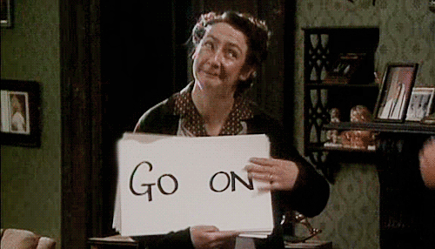
Your go!
Milgram and Bocchiaro
Piliavin and Levine
Bandura and Chaney
Sperry and Casey
Freud and Baron Cohen

Slide 14
Similarity AND Difference Questions
Tricky because people forget to give evidence on each side for each point of comparison

Slide 15
Outline one similarity and one difference between lab and field experiments [6]
The difference is its location.
Lab experiments are in a controlled environment
Whereas field experiments are in a natural environment
A similarity is control of the IV
In lab and field the IV is controlled by the researcher

Slide 16
Outline one similarity and one difference between lab and field experiments [6]
The difference is its location.
Lab experiments are in a controlled environment
Whereas field experiments are in a natural environment
A similarity is control of the IV.
For example, Haney = IV = prisoner or guard, controlled by researchers
Field experiment = Levine = IV as picking up pen, controlled by the researchers

Slide 17
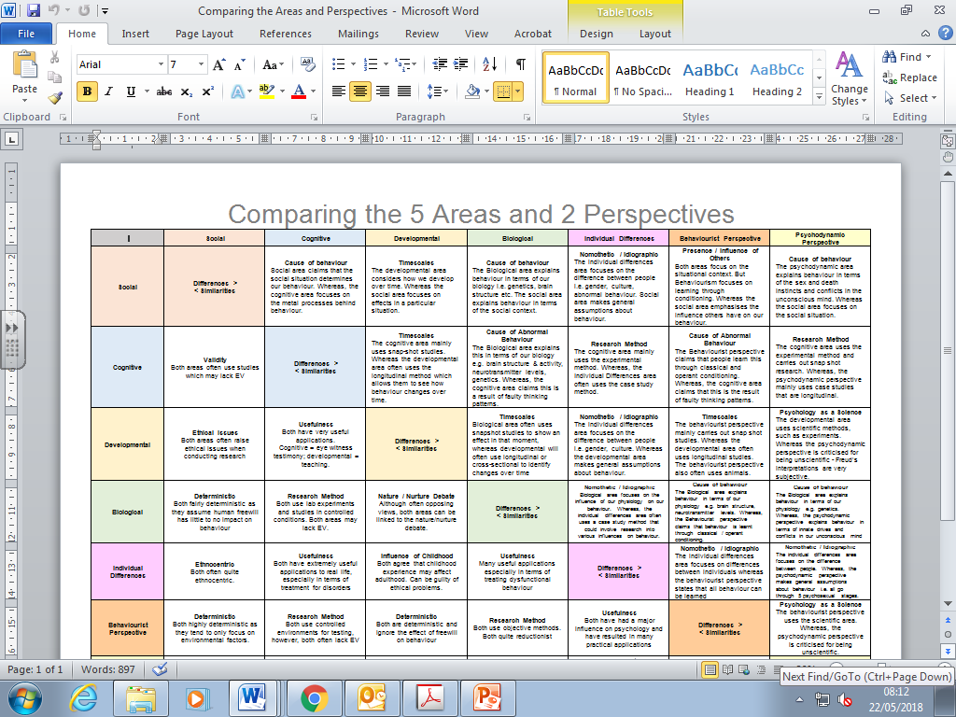
Comparisons
Explain 1 similarity and 1 difference between the individual differences area and the psychodynamic perspective. [6]

Slide 18
Debates are VERY difficult to compare
Keep the debates distinct in your mind
Watch out for conflation
reductionism is NOT the same as determinism
Ethics are not the same as socially sensitive research
Free Will / Determinism
Nature / nurture
Determinism can be linked to nature because both focus on establishing cause and effect, particularly when investigating genetics. Nurture also tends to be deterministic as behaviourist research believes that factors in the environment can be isolated and understood to be directly causing behaviour.
Individual / Situational Explanations
Determinism is similar to situational explanations that focus on specific factors which cause behaviour, which are predictable. Individual explanations tend to favour explanations that include freewill and are less predictable.
Reductionism / Holism
Determinism and reductionism have similar assumptions about behaviour being predictable and using a scientific approach to explain human behaviour.
Usefulness
Determinism is very useful when trying to develop treatments; but biological treatments may lack effectiveness in the long-term as behaviours return. Freewill is useful for developing therapies whereas determinism helps the development of very measurable treatments
Ethics
Determinism has the danger of causing psychological harm due to the implications research may have such as genetic causes of behaviour or poor upbringing
Socially Sensitive Research
Deterministic explanations can lead to socially sensitive research as they suggest there is a clear cause for behaviour. This can lead to labelling and discrimination and may remove personal responsibility.
Psych as a Science
Determinism aims to be scientific however it can never lead to perfect predictions due to the complexity of human behaviour and the difficulty isolating variables completely. Determinism does utilise many scientific methods compared to freewill.

Slide 19
Free Will / Determinism
Nature / nurture
Determinism can be linked to nature because both focus on establishing cause and effect, particularly when investigating genetics. Nurture also tends to be deterministic as behaviourist research believes that factors in the environment can be isolated and understood to be directly causing behaviour.
Individual / Situational Explanations
Determinism is similar to situational explanations that focus on specific factors which cause behaviour, which are predictable. Individual explanations tend to favour explanations that include freewill and are less predictable.
Reductionism / Holism
Determinism and reductionism have similar assumptions about behaviour being predictable and using a scientific approach to explain human behaviour.
Usefulness
Determinism is very useful when trying to develop treatments; but biological treatments may lack effectiveness in the long-term as behaviours return. Freewill is useful for developing therapies whereas determinism helps the development of very measurable treatments
Ethics
Determinism has the danger of causing psychological harm due to the implications research may have such as genetic causes of behaviour or poor upbringing
Socially Sensitive Research
Deterministic explanations can lead to socially sensitive research as they suggest there is a clear cause for behaviour. This can lead to labelling and discrimination and may remove personal responsibility.
Psych as a Science
Determinism aims to be scientific however it can never lead to perfect predictions due to the complexity of human behaviour and the difficulty isolating variables completely. Determinism does utilise many scientific methods compared to freewill.

Slide 20
Usefulness of research
Free Will / Determinism
Determinism is very useful when trying to develop treatments; but biological treatments may lack effectiveness in the long-term as behaviours return. Freewill is useful for developing therapies whereas determinism helps the development of very measurable treatments.
Nature/nurture
Taking the nature view is useful as it allows for nomothetic treatments to be designed. Taking the nurture view is useful in generating treatments which can be used by parents and schools.
Reductionism/ Holism
Being reductionist is very useful when trying to develop treatments; but biological treatments may lack effectiveness in the long-term as behaviours return. Being holistic is useful for developing therapies that will work for individuals whereas reductionism helps the development of very measurable treatments
Individual/ situational explanations
By understanding individual factors that determine behaviour researchers can develop real life applications such as CBT therapy that focuses on changing factors such as faulty cognitions.
Socially sensitive research
Often socially sensitive research has useful applications but the validity of research can be questioned
Ethics
One way to assess whether a study is ethically acceptable is to do a cost (in terms of psychological harm) and benefit (potential usefulness of the research) analysis.
Psych as a Science
Being scientific gives provable evidence, which can be trusted and relied on. This makes it useful to offer new treatments which people are more likely to follow.

Slide 21
Nature / nurture
Free Will / Determinism
Determinism can be linked to nature because both focus on establishing cause and effect, particularly when investigating genetics. Nurture also tends to be deterministic as behaviourist research believes that factors in the environment can be isolated and understood to be directly causing behaviour.
Reductionism / Holism
The nature view is reductionist because it focuses on establishing cause and effect, particularly when investigating genetics. Nurture also tends to be reductionist as it suggests that upbringing and the environment directly cause behaviour, and this ignores the impact of personality.
Individual / Situational Explanations
Individual explanations often assume that behaviour is innate and that the nurture side of the debate is true. By using a situational explanation researchers assume that the environment determines behaviour and therefore the nurture side of the nature/nurture debate is favoured.
Usefulness
Taking the nature view is useful as it allows for nomothetic treatments to be designed. Taking the nurture view is useful in generating treatments which can be used by parents and schools.
Ethics
Taking the nature view has the danger of causing psychological harm due to the implications research may have such as suggesting genetic causes of behaviour which a person can do nothing about. Taking the nurture view may cause psychological harm as it may blame mental health / crime on a poor upbringing
Socially Sensitive Research
A lot of socially sensitive research is about the genetic basis of behaviour and so is the nature side of debate.
Psych as a Science
The nature view links with Psychology as a science because it wants behaviour to be predictable and uses a scientific approach to explain human behaviour.

Slide 22
Reductionism / Holism
Free Will / Determinism
Determinism and reductionism have similar assumptions about behaviour being predictable and using a scientific approach to explain human behaviour.
Nature/nurture
The nature view is reductionist because it focuses on establishing cause and effect, particularly when investigating genetics. Nurture also tends to be reductionist as it suggests that upbringing and the environment directly cause behaviour, and this ignores the impact of personality.
Individual/ situational explanations
Situational explanations are often hard to quantify when explaining how other people and the environment causes behaviour and so a more holistic approach is needed.
Usefulness
Being reductionist is very useful when trying to develop treatments; but biological treatments may lack effectiveness in the long-term as behaviours return. Being holistic is useful for developing therapies that will work for individuals whereas reductionism helps the development of very measurable treatments
Ethics
Narrowing the cause of behaviour to single variables (reductionism) may cause psychologists to deceive Ps when they are researching or fail to get informed consent.
Socially sensitive research
Reductionist as often socially sensitive research focuses on a specific trait such as sex or race, as the cause of a behaviour.
Psych as a Science
Being scientific tends to make the research and explanations of behaviour reductionist.

Slide 23
Individual/ situational explanations
Free Will / Determinism
Determinism is similar to situational explanations that focus on specific factors which cause behaviour, which are predictable. Individual explanations tend to favour explanations that include freewill and are less predictable.
Nature / nurture
Individual explanations often assume that behaviour is innate and that the nurture side of the debate is true. By using a situational explanation researchers assume that the environment determines behaviour and therefore the nurture side of the nature/nurture debate is favoured.
Reductionism / Holism
Situational explanations are often hard to quantify when explaining how other people and the environment causes behaviour and so a more holistic approach is needed.
Usefulness
By understanding individual factors that determine behaviour researchers can develop real life applications such as CBT therapy that focuses on changing factors such as faulty cognitions.
Ethics
Situational explanations can be seen as removing individual responsibility whilst individual explanations risk labelling. Both have a level of psychological harm.
Socially sensitive research
The danger of attributing the cause of behaviour to individual factors is that it can lead to socially sensitive research as the implications of findings could suggest that a person’s race, age, gender or disability cause behaviours. This can cause social stigmas and discrimination.
Psych as a Science
Areas of psychology that use individual explanations of behaviour (e.g. the cognitive area), often use scientific methods that are highly controlled whereas situational explanations often find it harder to establish such high control.

Slide 24
Ethics
Free Will / Determinism
Determinism has the danger of causing psychological harm due to the implications research may have such as genetic causes of behaviour or poor upbringing
Nature/nurture
Taking the nature view has the danger of causing psychological harm due to the implications research may have such as suggesting genetic causes of behaviour which a person can do nothing about. Taking the nurture view may cause psychological harm as it may blame mental health / crime on a poor upbringing
Reductionism/ Holism
Narrowing the cause of behaviour to single variables (reductionism) may cause psychologists to deceive Ps when they are researching or fail to get informed consent.
Individual/ situational explanations
Situational explanations can be seen as removing individual responsibility whilst individual explanations risk labelling. Both have a level of psychological harm.
Usefulness
One way to assess whether a study is ethically acceptable is to do a cost (in terms of psychological harm) and benefit (potential usefulness of the research) analysis.
Socially sensitive research
Often socially sensitive research causes psychological harm
Psych as a Science
The BPS guidelines encourage psychologists to have respect, competence, responsibility and integrity. This should encourage them to take a scientific approach to research.

Slide 25
Socially sensitive research
Free Will / Determinism
Deterministic explanations can lead to socially sensitive research as they suggest there is a clear cause for behaviour. This can lead to labelling and discrimination and may remove personal responsibility.
Nature/nurture
A lot of socially sensitive research is about the genetic basis of behaviour and so is the nature side of debate.
Reductionism / Holism
Reductionist as often socially sensitive research focuses on a specific trait such as sex or race, as the cause of a behaviour.
Individual / situational explanations
The danger of attributing the cause of behaviour to individual factors is that it can lead to socially sensitive research as the implications of findings could suggest that a person’s race, age, gender or disability cause behaviours. This can cause social stigmas and discrimination.
Usefulness
Often socially sensitive research has useful applications but the validity of research can be questioned
Ethics
Often socially sensitive research causes psychological harm
Psych as a Science
Research must try to be scientific if it is to be trusted and to reduce implications of socially sensitive research such as incorrect interpretations of data.

Slide 26
Psych as a science
Free Will / Determinism
Determinism aims to be scientific however it can never lead to perfect predictions due to the complexity of human behaviour and the difficulty isolating variables completely. Determinism does use many more scientific methods compared to freewill.
Nature/nurture
The nature view links with Psychology as a science because it wants behaviour to be predictable and uses a scientific approach to explain human behaviour.
Reductionism / Holism
Being scientific tends to make the research and explanations of behaviour reductionist.
Individual / situational explanations
Areas of psychology that use individual explanations of behaviour (e.g. the cognitive area), often use scientific methods that are highly controlled whereas situational explanations often find it harder to establish such high control.
Usefulness
Being scientific gives provable evidence, which can be trusted and relied upon. This makes it useful to offer new treatments.
Ethics
The BPS guidelines encourage psychologists to have respect, competence, responsibility and integrity. This should encourage them to take a scientific approach to research.
Socially Sensitive Research
Research must try to be scientific if it is to be trusted and to reduce implications of socially sensitive research such as incorrect interpretations of data.

Slide 27
Questions to try in your revision: Paper 1
Explain one difference between a field and a natural experiment [3]
Explain the difference between a participant and non-participant observation. [3]
Explain one difference between an independent measures design and a repeated measures design [3]
Explain one difference between researcher bias and researcher effects [3]
Explain one difference between an open and a closed question. [3]
Explain one difference between volunteer and opportunity sampling [3]
Explain one difference between time and event sampling in observations. [3]

Slide 28
Questions to try in your revision: Paper 2
Explain one difference between the Developmental area and the Behaviourist perspective [3]
Explain one similarity between the Social Area and the Situational Explanation of behaviour. [3]
Explain one difference between the Biological area and the nurture side of the nature nurture debate [3]

Slide 29
Questions to try in your revision: Paper 2
Explain one difference between the genetic and biochemical explanations of mental illness [3]
Explain one similarity between physiological and non-physiological explanations of criminal behaviour [3]
Explain one difference between punishment and reform as responses to criminal behaviour [3]

